Slide 1
Ensemble Deep Learning for Image Classification

Slide 2
Introduction: What is image classification
Image classification is a procedure in image processing to automatically classify a large number of images based on its visual content.
The intent of the classification process is to categorize similar images into predefined meaningful classes.
Image Classification Application:
Remote sensing
Agriculture
Medicine
Military
Food Processing
Industrial Automation

Slide 3
Literature Review
Earlier machine learning algorithms were used for image classification which showed a notable accuracy. Tanmpy Das used five classification schemes, namely Nearest Class Centroid classifier, Nearest Subclass Centroid classifier using the number of classes in the subclasses in the set, Nearest Neighbour classifier, Perceptron trained using Backpropagation, Perceptron trained using MSE.

Slide 4
Deep Learning based Image Classification
Deep Learning is a subset of Machine Learning Algorithms that is very good at recognizing patterns but typically requires a large number of data.
Deep learning excels in recognizing objects in images as it’s implemented using 3 or more layers of artificial neural networks where each layer is responsible for extracting one or more feature of the image (more on that later).
Neural Network is a computational model that works in a similar way to the neurons in the human brain. Each neuron takes an input, performs some operations then passes the output to the following neuron.

Slide 5
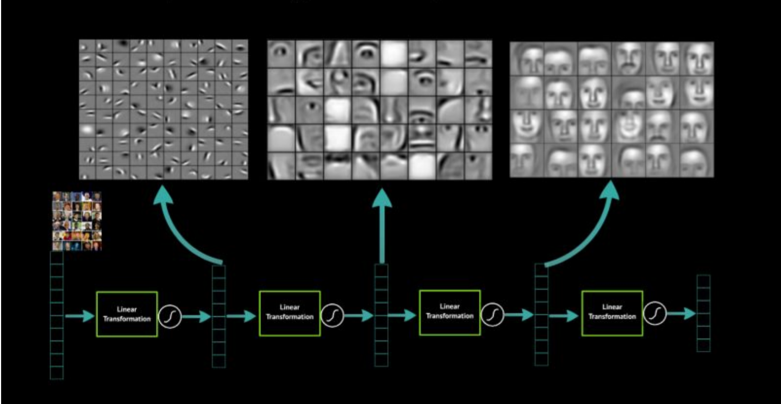
Why does it work so well?

Slide 6
Why choose deep learning?
After going through all the options available to us for image classification , we found out that deep learning suits the best for large scale image classification.
This is because of the huge advantage of multi-layered models such as the CNNs where in each layer, different level of visual information is processed.
Lower layers process (detect) very local features; just small parts of curves etc. The higher you get, the more complex features are concerned. And you can still interpret the functionality of the network relatively well.
Commonly, to adapt a model to new purpose, its lower layers are kept and you only train the higher ones to infer the features for the particular case. That speeds the training.

Slide 7
Ensemble Learning
Ensemble learning is one of the various prototypes of deep learning which is advantageous in various machine learning applications. Ensemble method can be thought of as a machine learning model that involves a set of various individual models working parallelly on the same dataset to produce a better accuracy result as compared to any of the individual models working alone . This ensemble model comprises of three individual models – Convolutional Neural Network(CNN), Long Short Term Memory networks(LSTM) and Multi-layer Perceptron Network (MLP).. We would be using this powerful tool to categorise images in the Fashion MNIST dataset which comprises of 60,000 training dataset images and 10,000 test images.

Slide 8
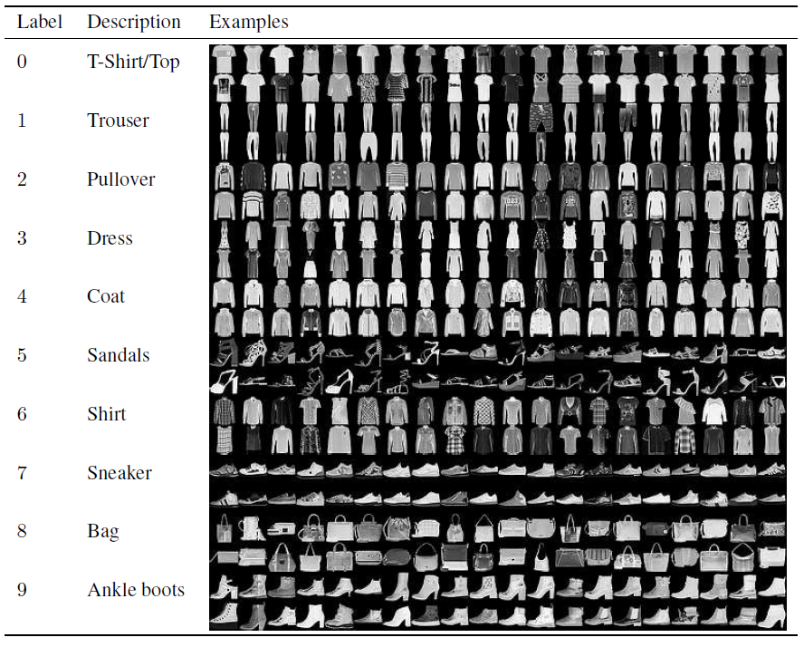
Dataset
Fashion MNIST dataset comprises of 60,000 test set images each of which has 784 features (i.e. 28×28 pixels).
Each pixel has a value between 0 to 255 where 0 is for white and 255 signifies black.
All the images in the dataset have light gray background((hexadecimal color: #fdfdfd) and the products fall in different categories like - men, women, kids and neutral.
All the images of Fashion MNIST dataset are classified into one of the following 10 categories - t-shirts, trousers, pullovers, dresses, coats, sandals, shirts, sneakers, bags, and ankle boots.

Slide 9

Convolutional Neural Network(CNN)
Convolutional Neural Network is a deep learning archetype that is predominantly used to classify images and group them based on similarity in features.
It encompasses three types of layers - convolutional layers, pooling layers and fully-connected layers.
Extraction of high-level features from the image is done by the convolutional layer.
The Pooling layer is liable for reducing the spatial size of the resultant feature from Convolutional layer.
The fully connected layer performs the combination matching and classification by revising the nonlinear activation function.
It is one of the highly sought-after image classification algorithms and is rooted on the idea that local understanding of image is enough to predict good results.

Slide 10
CNN Architecture Used
The architecture we experimented with consists of 3 layers: 2 Convolutional, 2 Pooling and 2 Fully connected layers.
Filters of dimensions 5x5 and 3x3 are used in the 2 convolutional layers to produce feature maps.
ReLU activation function is used in these two layers to add non-linearities.
Each convolutional layer is followed by a Max Pooling layer to downsample the data.
A dense layer of 128 neurons with ReLU activation is added to make the network more sophisticated.
A fully connected layer with softmax activation serves as the output layer.

Slide 11
Long Short-Term Memory (LSTM)
LSTM models have evidently outperformed RNNs on learning context-free and context-sensitive languages.
The key difference between traditional RNNs and LSTMs is that later can avoid the long-term dependency issue and work for either long or short time spans
An LSTM unit is composed of a cell, an input gate, an output gate and a forget gate.
The cell is responsible for collecting the value and the three gates modulate the flow of information into and out of the cell.
LSTM networks are expedient to carry out classification, processing and prediction chores based on time series data.

Slide 12
LSTM Architecture Used
LSTM has been known to perform well on data which have periodic patterns.
The image data can be comprehended as each image representing 28 inputs for 28 time steps.
The model has only 1 LSTM layer followed by the fully connected output layer with softmax activation.

Slide 13
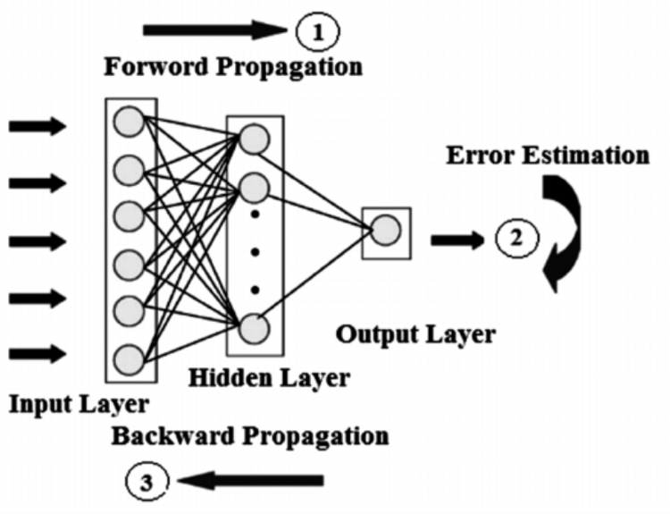
Multi-Layer Perceptron (MLP)
A multi-layer perceptron(MLP) network belongs to the class of feedforward artificial neural network.
It comprises of input layer, hidden layers and an output layer.
MLP employs a supervised learning mechanism namely backpropogation for training.
It has two common activation functions hyperbolic tangent which ranges from -1 to 1 and logistic function which ranges from 0 to 1.

Slide 14
MLP Architecture Used
Each input vector is mapped to a class label, belonging to one of the categories. Since MLP needs the input as a vector, images need to be pre-processed.
Each 28x28 grayscale image has 28*28 = 764 pixel values.
Therefore, each image is flattened and 764 features contribute as the input vector for the MLP.
The MLP model has 3 dense layers with 512 neurons and ReLU activation, each followed by a dropout layer to prevent overfitting.
The output layer is a fully connected layer with softmax activation.

Slide 15
Ensemble Voting Classifier
The three individual base models have softmax activation function in the output layer. The trained models are used to predict the probabilities of the 10 classes for the image data. For selecting the class predicted by the ensemble classifier, two different techniques are used: Hard voting and Soft voting.
Hard voting predicts the class which was predicted by the majority of the base models. In the case when each of the models predicts a different class and there is no unique mode, the class with the highest probability is selected.
Soft voting takes the mean of probabilities of each class for the three base models, and predicts the class with the highest mean. We used weighted mean of the probabilities for soft voting in order to vary the contribution of the individual models in the ensemble.

Slide 16
Activation Functions
In artificial neural networks, the activation function of a node defines the output of that node, or "neuron," given an input or set of inputs. This output is then used as input for the next node and so on until a desired solution to the original problem is found. It maps the resulting values into the desired range such as between 0 to 1 or -1 to 1 etc. (depending upon the choice of activation function). For example, the use of the logistic activation function would map all inputs in the real number domain into the range of 0 to 1. Activation functions are used to add non-linearities to the network.

Slide 17
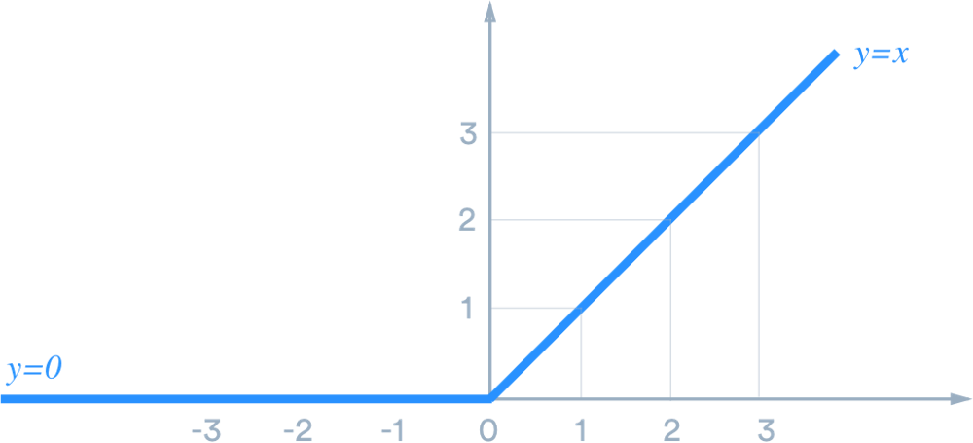
Rectified Linear Unit Function (ReLU)
ReLU stands for rectified linear unit, and is a type of activation function. Mathematically, it is defined as y = max(0, x).
ReLU is the most commonly used activation function in neural networks, especially in CNNs.
If you are unsure what activation function to use in your network, ReLU is usually a good first choice.
ReLU is linear (identity) for all positive values, and zero for all negative values.
ReLU has been used in the hidden layers in our architectures for activation.

Slide 18
Softmax Function
The softmax function, also known as softargmax or normalized exponential function is a function that takes as input a vector of K real numbers, and normalizes it into a probability distribution consisting of K probabilities.
That is, prior to applying softmax, some vector components could be negative, or greater than one; and might not sum to 1; but after applying softmax, each component will be in the interval and the components will add up to 1, so that they can be interpreted as probabilities.
Furthermore, the larger input components will correspond to larger probabilities.
Softmax is often used in neural networks, to map the non-normalized output of a network to a probability distribution over predicted output classes.

Slide 19
Experimental Results
The proposed algorithm was implemented on all the above mentioned corpora and the results obtained are discussed in this section.
The experiments were performed using Python 3.6 on a Dell hex core (2.4 GHz.) laptop with Nvidia GeForce GTX 1060 GPU.
Under the given conditions, experimental evidence shows the ensemble algorithm performed quite robustly in almost all the cases and outperformed the established deep learning models in terms of accuracy.
The accuracy obtained by individual models on test data are: 0.8687 for MLP, 0.8904 for LSTM and 0.9141 for CNN.
The accuracy for Ensemble model using hard voting comes out to be 0.9064 while it reaches 0.9178 for weighted soft voting.

Slide 20
The experiments show that CNN performs the best among the individual base learners for image classification of the Fashion MNIST dataset, while MLP performs the worst. The hard voting technique which takes the majority of the predictions is better than LSTM and MLP, however doesn’t match up to the accuracy of CNN. The soft averaging technique is comparable to the CNN in terms of performance. The soft voting technique is modified with weights associated with each of the models in the ratio 1:1:2 for MLP, LSTM and CNN respectively. The modified architecture shows improvement in accuracy and even outperforms the CNN, which is the most practiced image classification technique.
Models |  | Accuracy (%)
MLP |  | 86.87
LSTM |  | 89.04
CNN |  | 91.41
Ensemble | Hard voting | 90.64
 | Soft voting | 91.37
 | Weighted Soft voting | 91.78

Slide 21
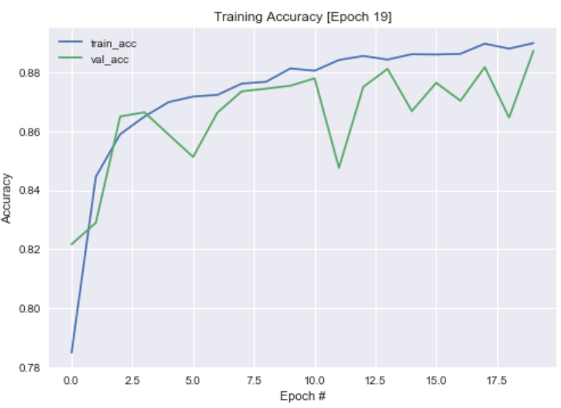
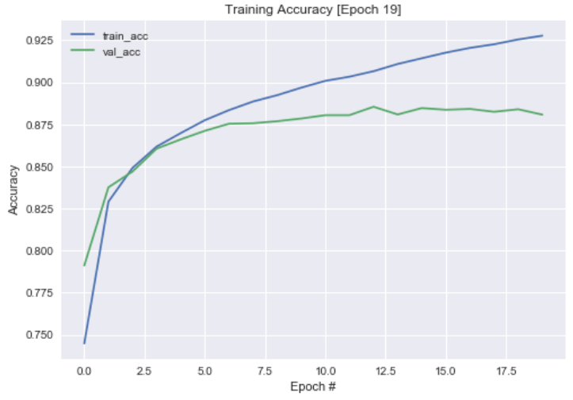
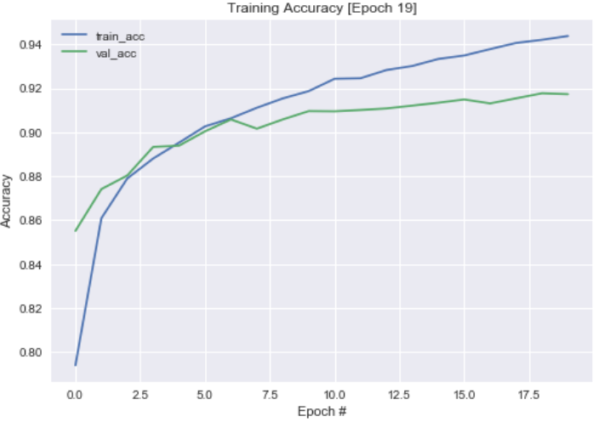
Graphs
Accuracy vs Epochs graph for MLP
Accuracy vs Epochs graph for LSTM
Accuracy vs Epochs graph for CNN

Slide 22
References
Faliang Huang, Guoqing Xie, Ruliang Xiao. Research on Ensemble Learning
Han Xiao, Roland Vollgraf, Kashif Rasul. Fashion-MNIST: a Novel Image Dataset for Benchmarking Machine Learning Algorithms
Keiron Teilo O’Shea , Ryan Nash. An Introduction to Convolutional Neural Networks
Shuning Shen. Image Classification of Fashion-MNIST Dataset Using Long Short-Term Memory Networks
Guifang Lin, Wei Shen . Research on convolutional neural network based on improved Relu piecewise activation function
Hassan Ramchoun, Mohammed Amine Janati Idrissi, Youssef Ghanou, Mohamed Ettaouil. Multilayer Perceptron: Architecture Optimization and Training
Has¸im Sak, Andrew Senior, Franc¸oise Beaufays. Long Short-Term Memory Recurrent Neural Network Architectures for Large Scale Acoustic Modeling.

Slide 23
THANK YOU

